Slide 1
RADAR
Using Arduino and Ultrasonic Sensor
Prepared By Yuval (B22CSE019) and Aashka (B22CSE022)

Slide 2
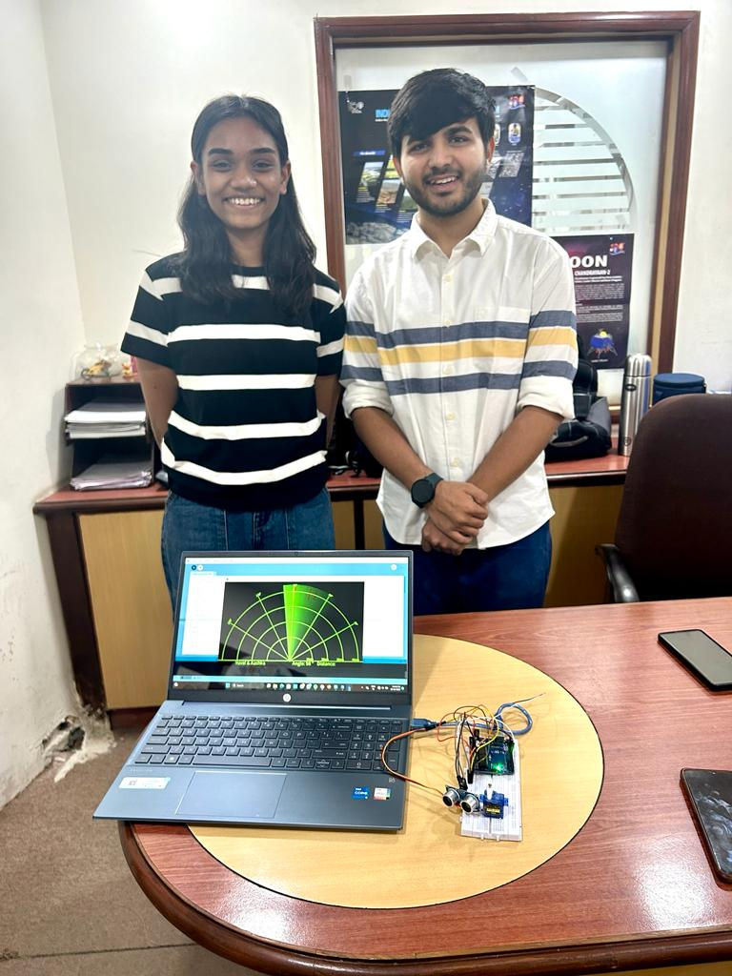
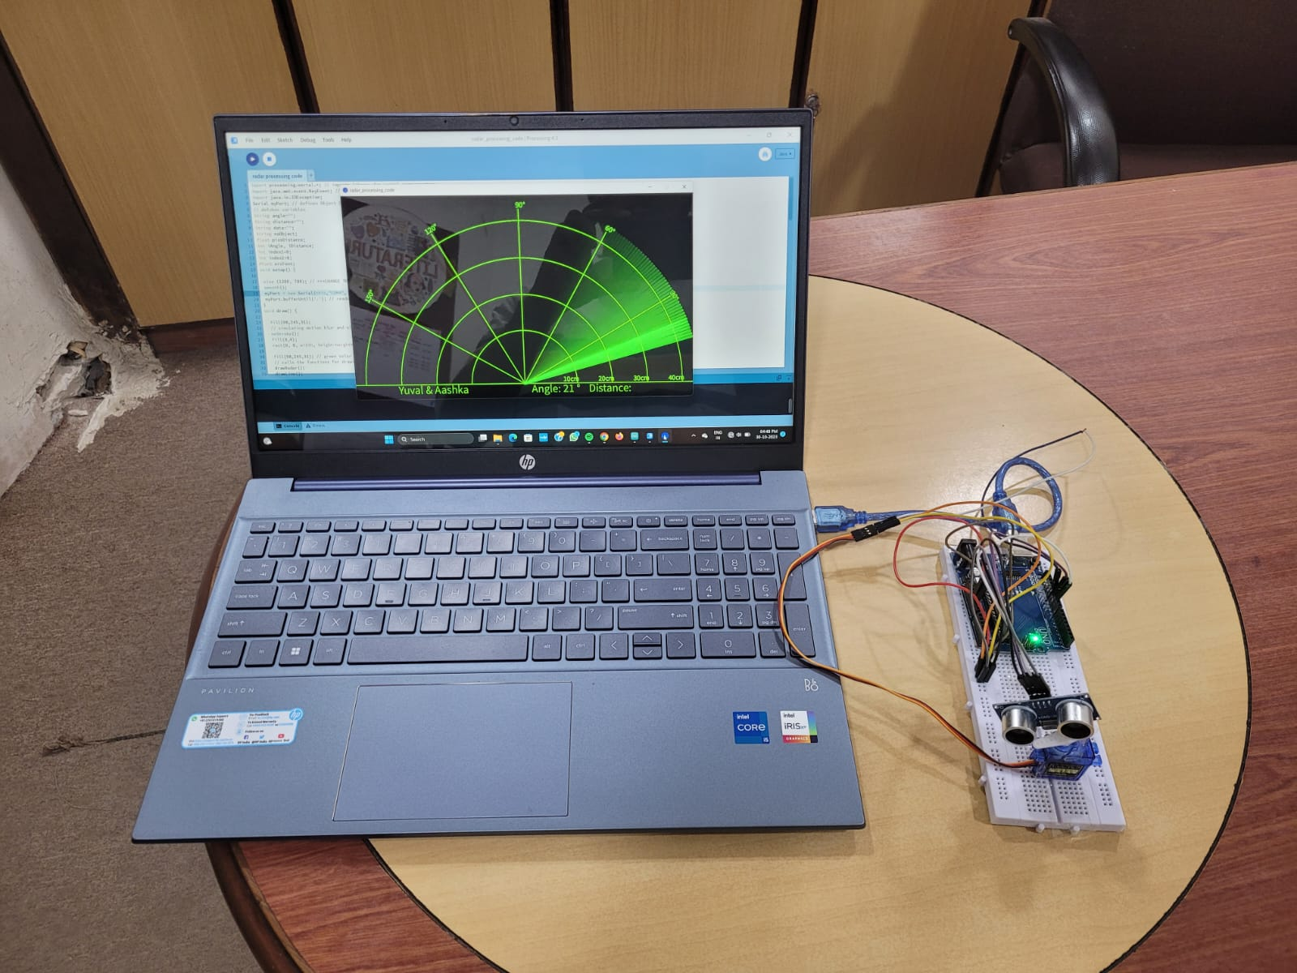
Real-time Project

Slide 3
Working Of The Project
The Project works on the base of the ultrasonic sensor sensing the objects in its range.
We have used an Arduino, Servo motor, Ultrasonic sensor, Jumper wires and a Bread board.
We have fixed a definite range for the ultrasonic sensor to scan fixed on the servo motor which rotates at a certain angle.
Once the wire is connected to Arduino and the processing code is run the power supply is given and the servo motor starts rotating with the ultrasonic sensor scanning for any object in range of its radius
Its detects object and is displayed on the screen giving a red sign in that area.
The Sensor keeps working until there is a provided power supply.

Slide 4
Thank You

